Slide 1
PriceKing – Realtime Best Deal Search and Analytics
Team Members:
Deven Pawar (009275994)
Hardik Joshi (008733387)
Naiya Shah (009269637)
Vinay Bhore (009290931)

Slide 2
Contents
Motivation
Idea
Vision
Application Features
Architecture
Web Application
PriceKing Algorithm
Mobile App

Slide 3
Idea!
131.4 million mobile shoppers!
305 billion CPG(ConsumerProduct Goods) coupons are distributed and only 2.9 billion are redeemed!
To create a mobile app that finds good deal
We can make Economic, Social and Environment Impact
Lot of business!

Slide 4
Motivation
The World of commerce is dominated by giants like Amazon, eBay, Target, Walmart…….
Price by comparing different websites is challenging!
Even difficult to search for coupons which goes with the product

Slide 5
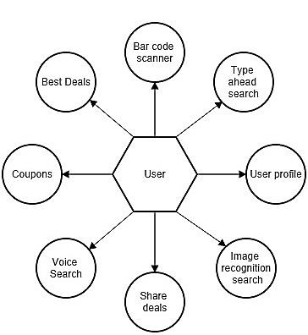
Features for application users

Slide 6
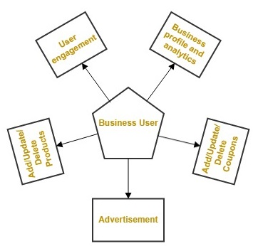
Features for small businesses

Slide 7
e-Commerce websites
Small Businesses
Purchase
Promotions
User
Product listing
Coupons listing
Increased sale
Advertisement
User profile
Notifications
Recommendations
Analytics

Slide 8
Background and Related work
API and Application Layer | Restful Web Service Spring MVC Tomcat
Database Layer | MongoDB
UI Layer | HTML5 CSS3 JQuery JavaScript JSP Twitter Bootstrap AngularJS
Messaging | Apache Kafka Storm Esper
Deployment | Play Store Amazon EC2
Mobile Client | Android
Testing | Selenium Web Driver Testdroid Rest Console JUnit

Slide 9
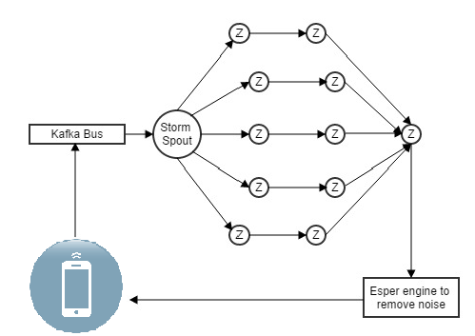
Architecture
eBay bolt
Amazon bolt
Walmart bolt
Aggregator
Target bolt
Small businesses bolt

Slide 10
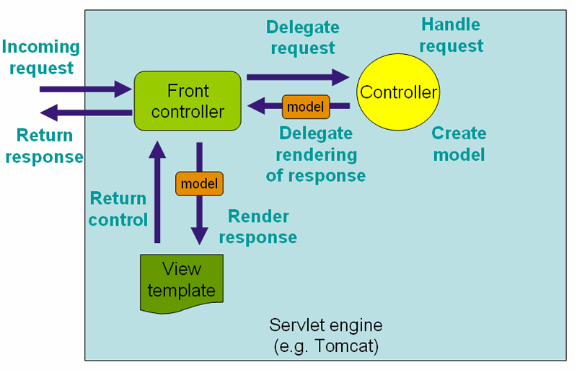
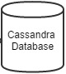
Architecture (Small Businesses)
Restful Webservice

Slide 11
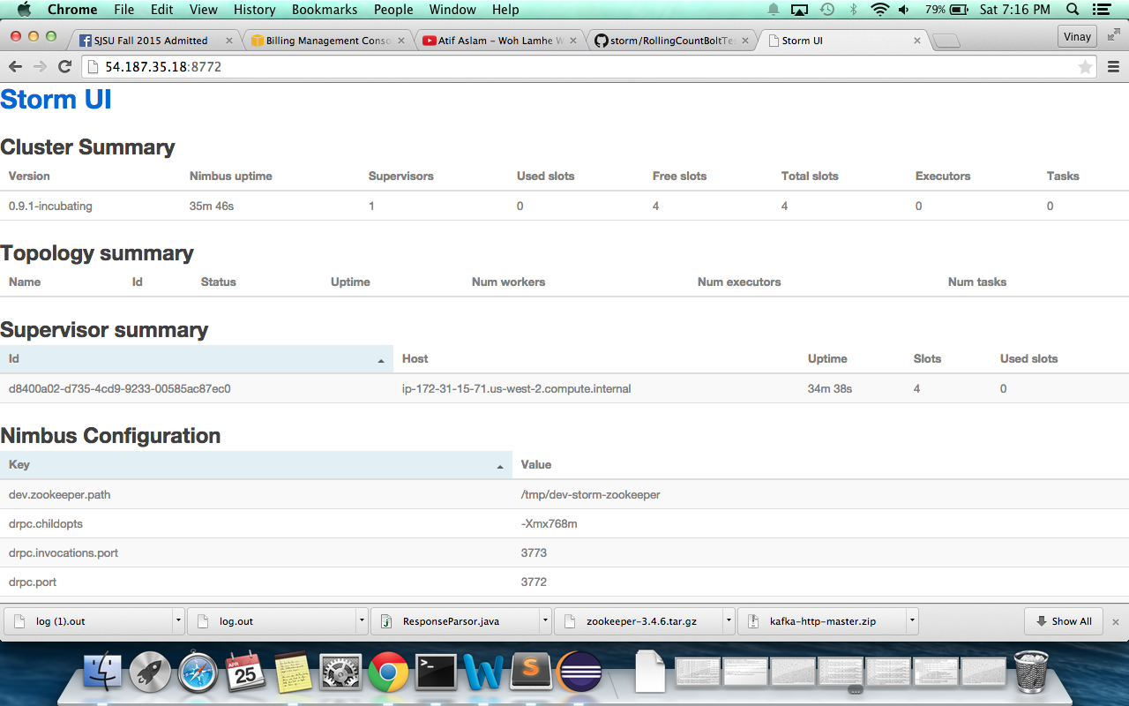
Storm on Cloud

Slide 12
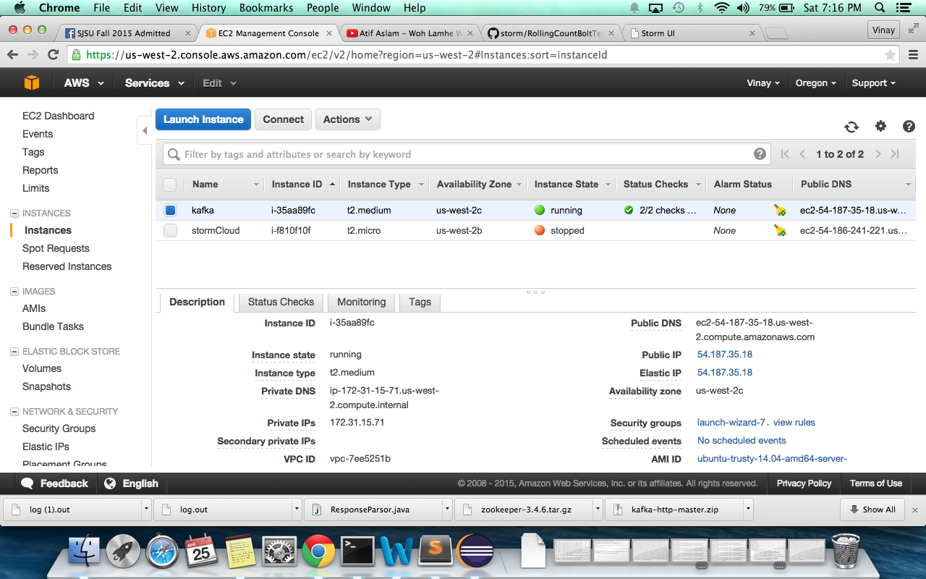

Slide 13
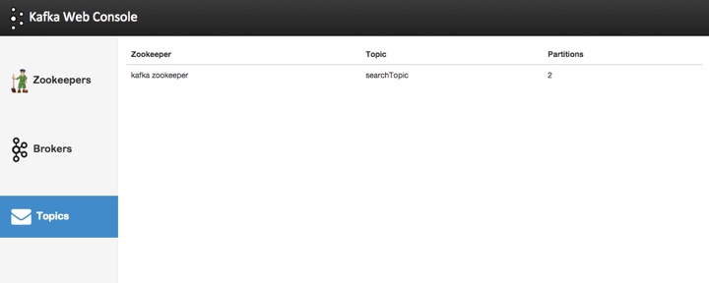
Kafka Web Console

Slide 14
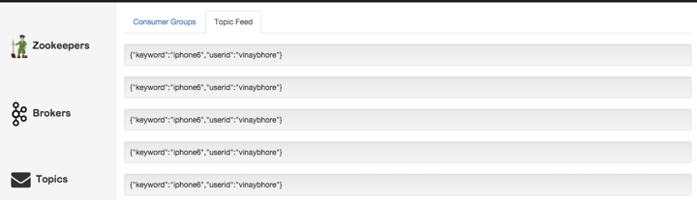
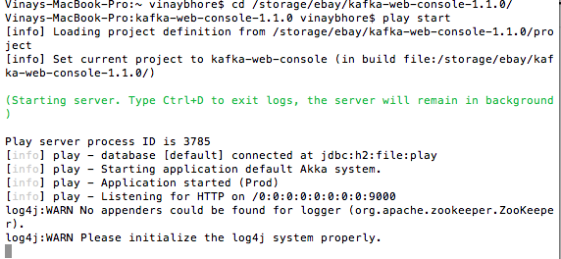

Slide 15
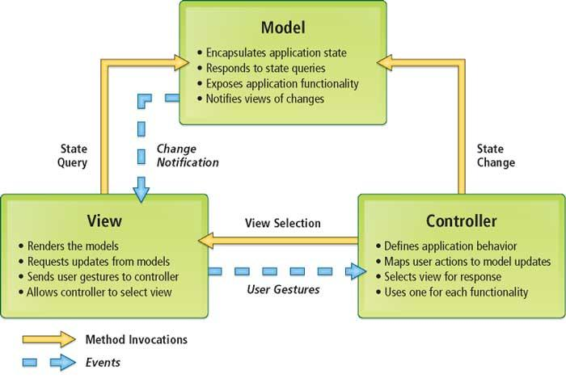
MVC - Backend

Slide 16
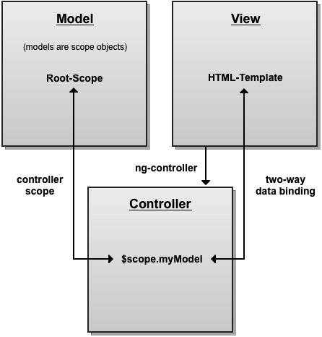
MVC - Frontend

Slide 17
PriceKing Algorithm
API Crawling
Parsing response in a common format
Filter
Compare and Sort
Aggregate

Slide 18
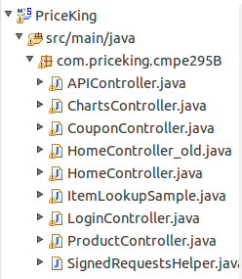
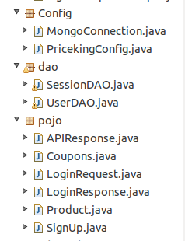
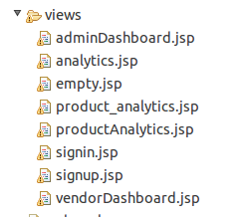
Project Structure

Slide 19
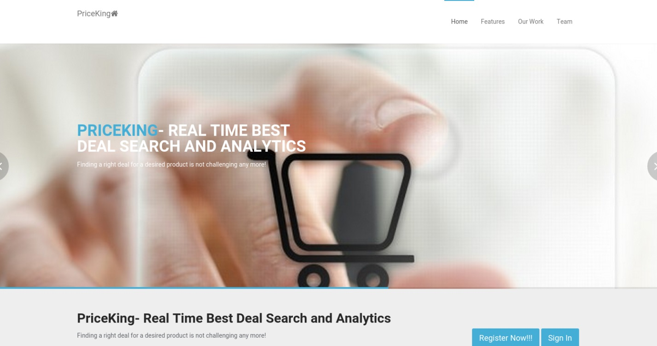
Home

Slide 20
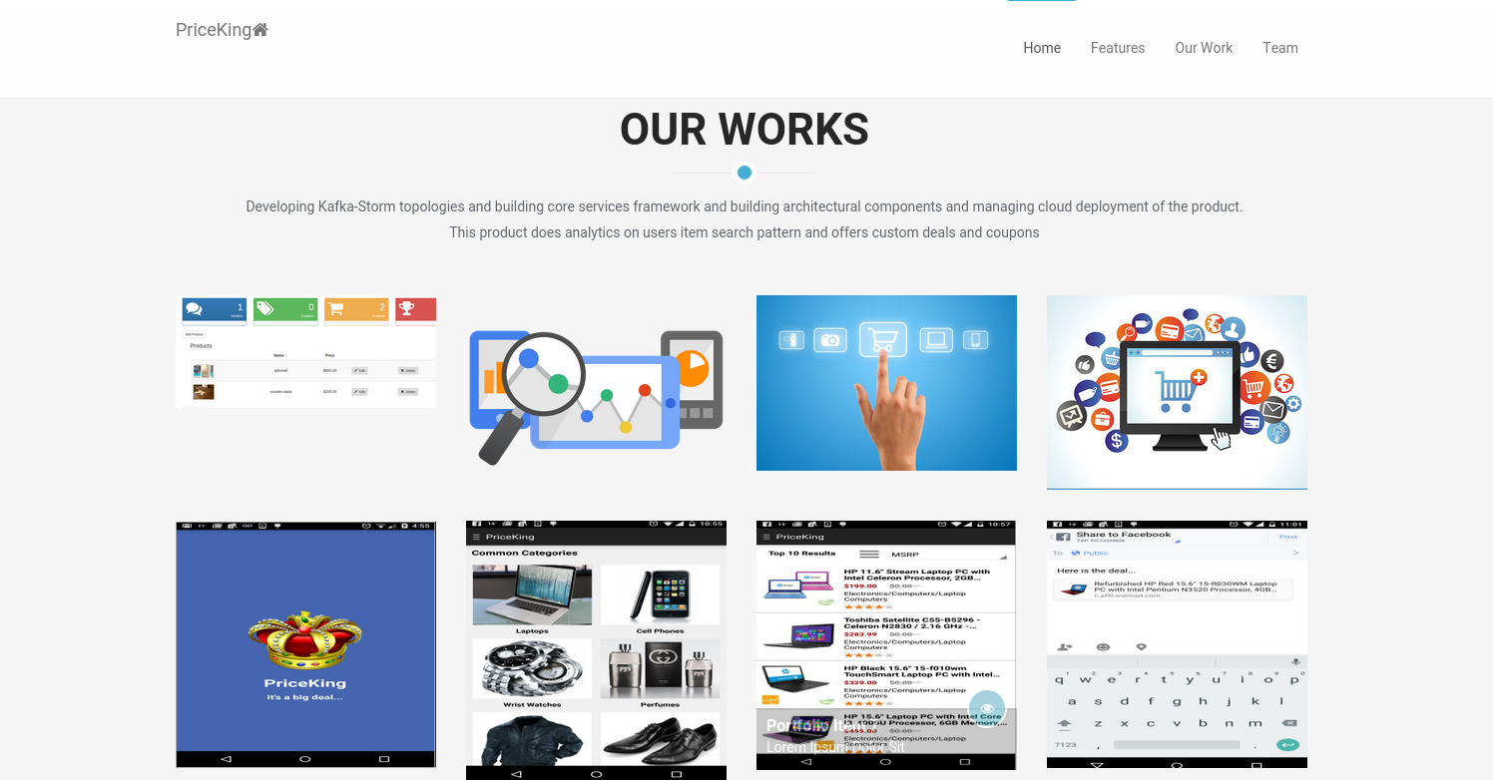
Home(1)

Slide 21
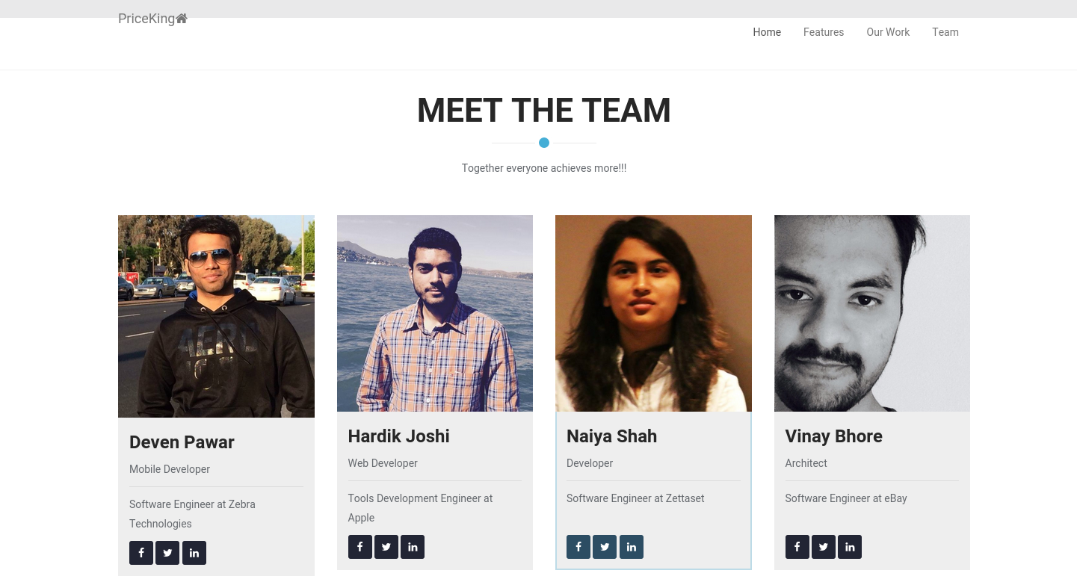
Home(2)

Slide 22
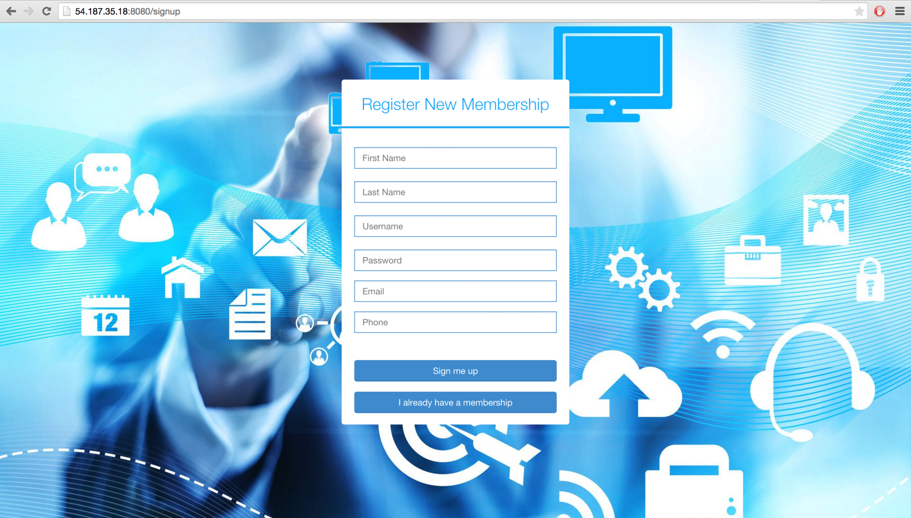
SignUp

Slide 23
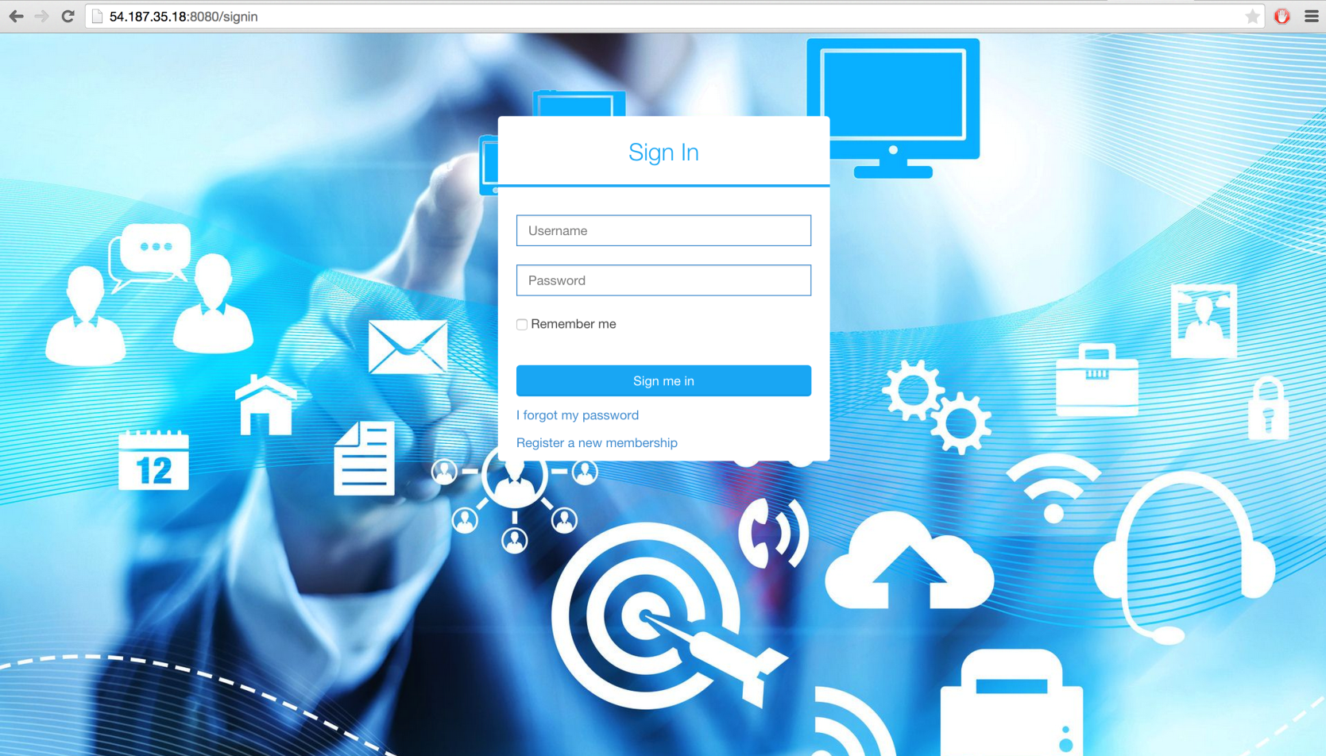
SignIn

Slide 24
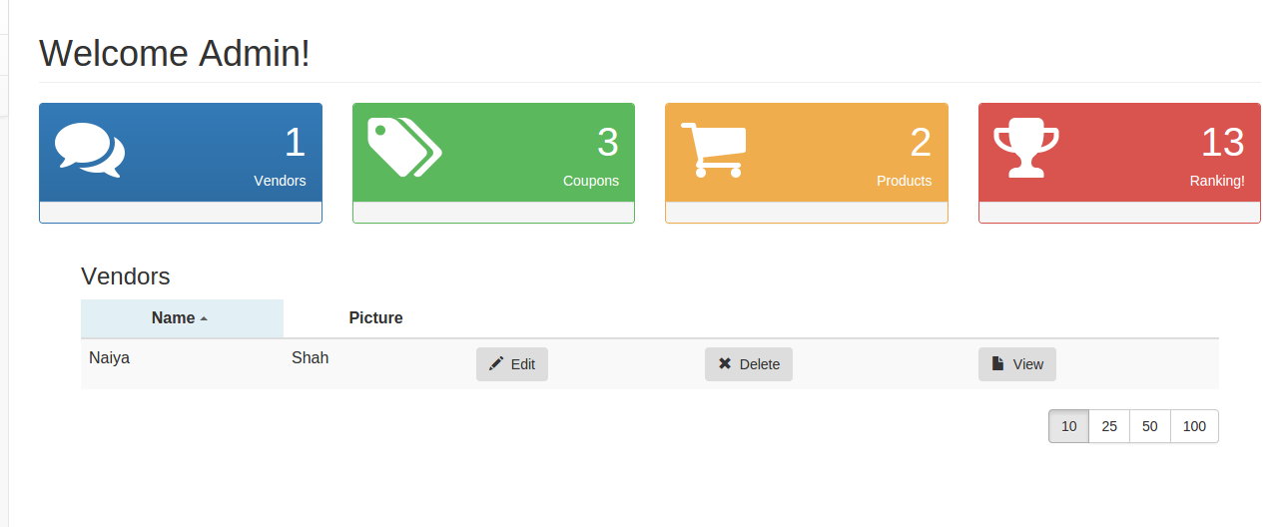
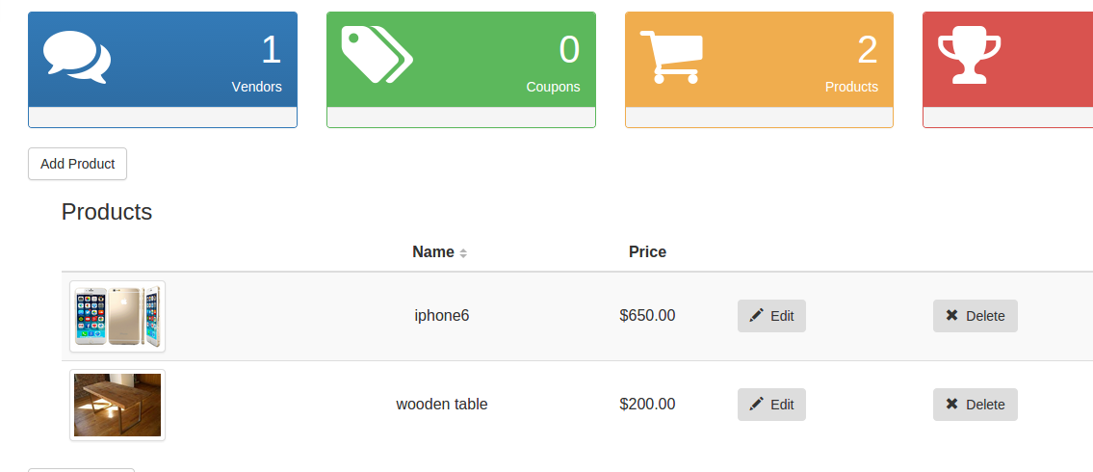
Vendor/Admin Dashboard

Slide 25
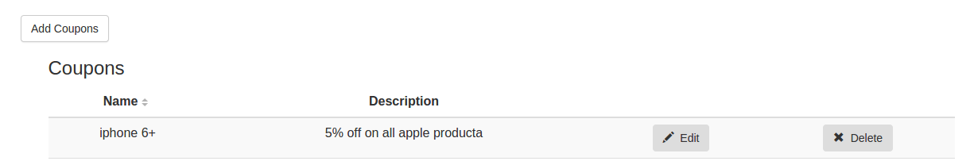
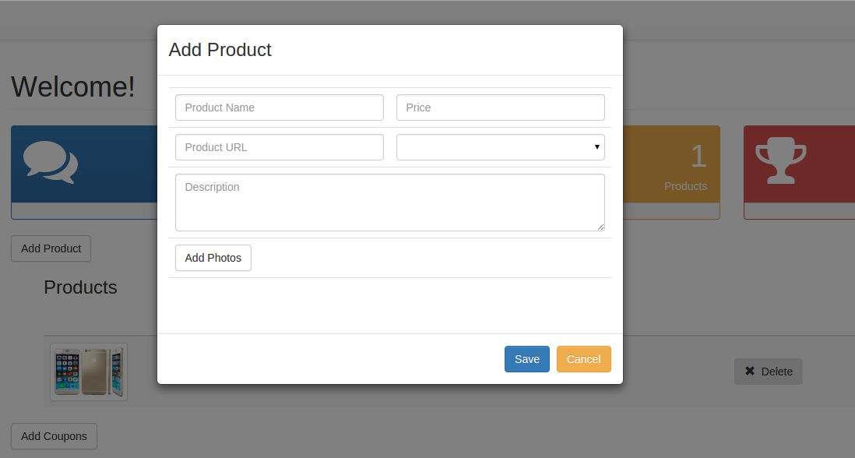
Add Product/Coupon

Slide 26
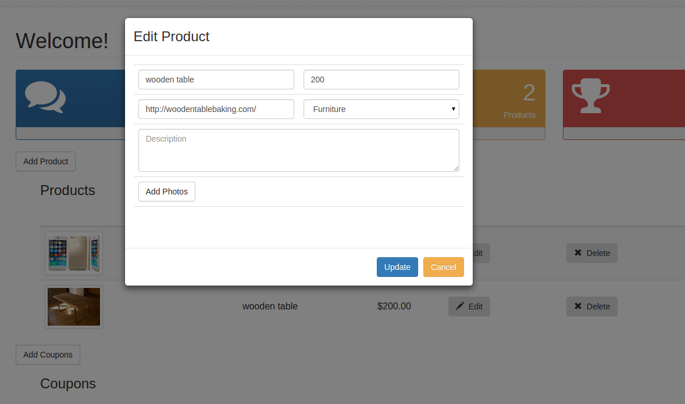
Edit Product

Slide 27
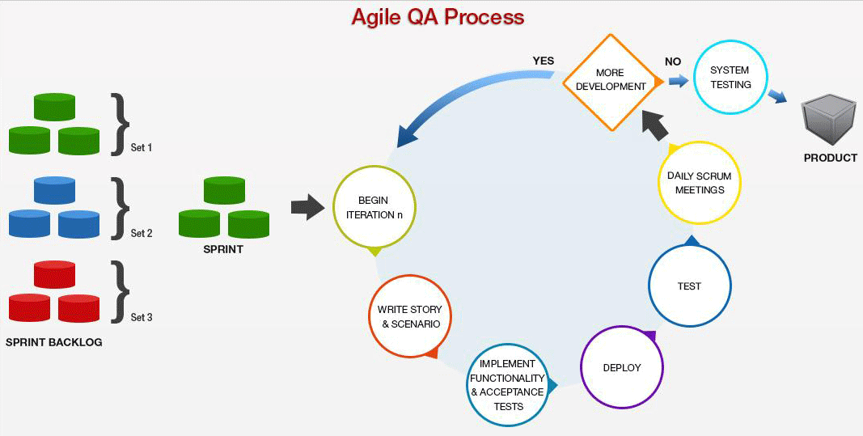
Agile QA Process

Slide 28
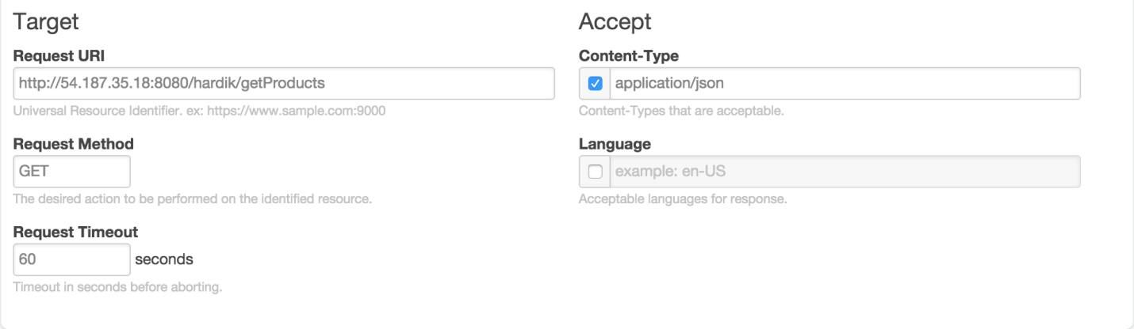
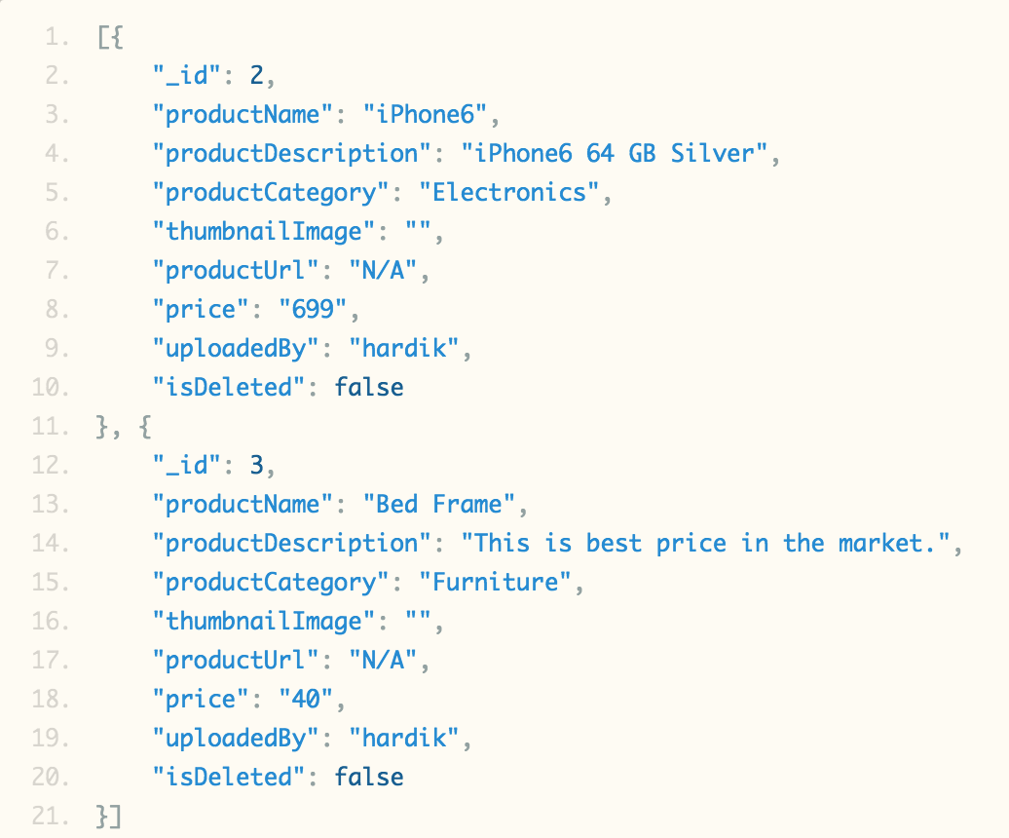
API Testing- Rest Console

Slide 29
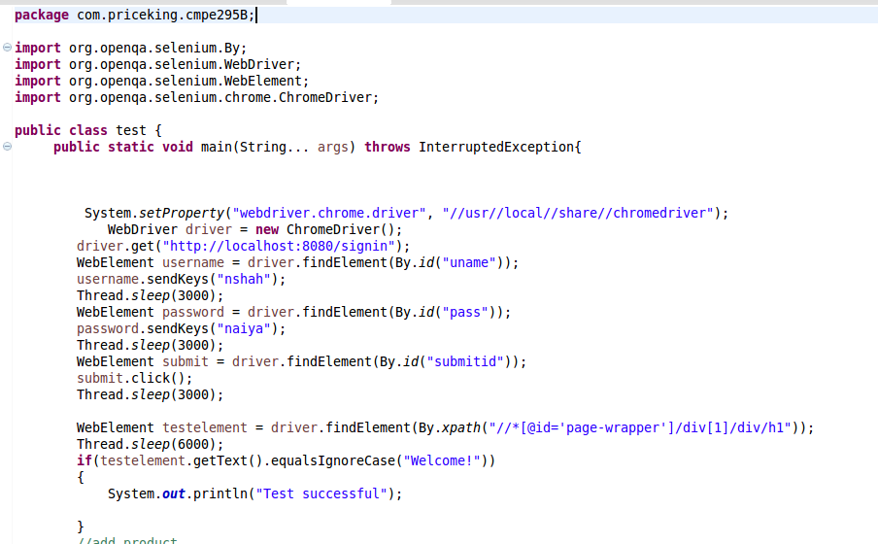
Functionality and UI Testing-Selenium

Slide 30
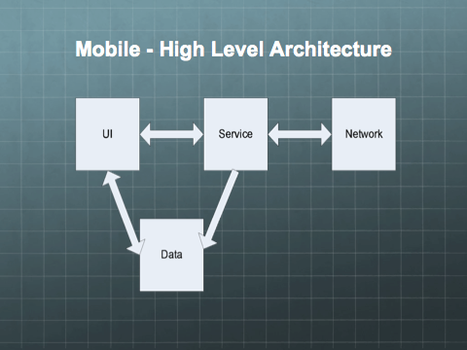

Slide 31
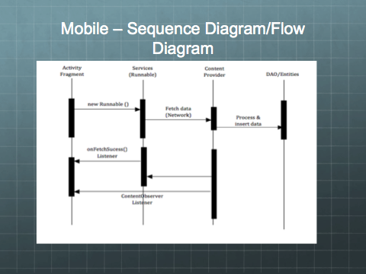

Slide 32
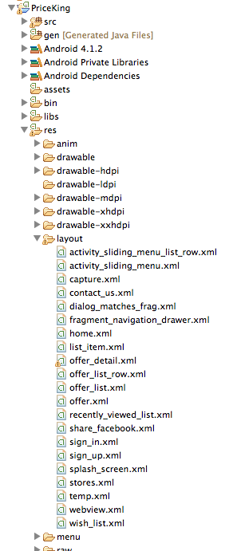
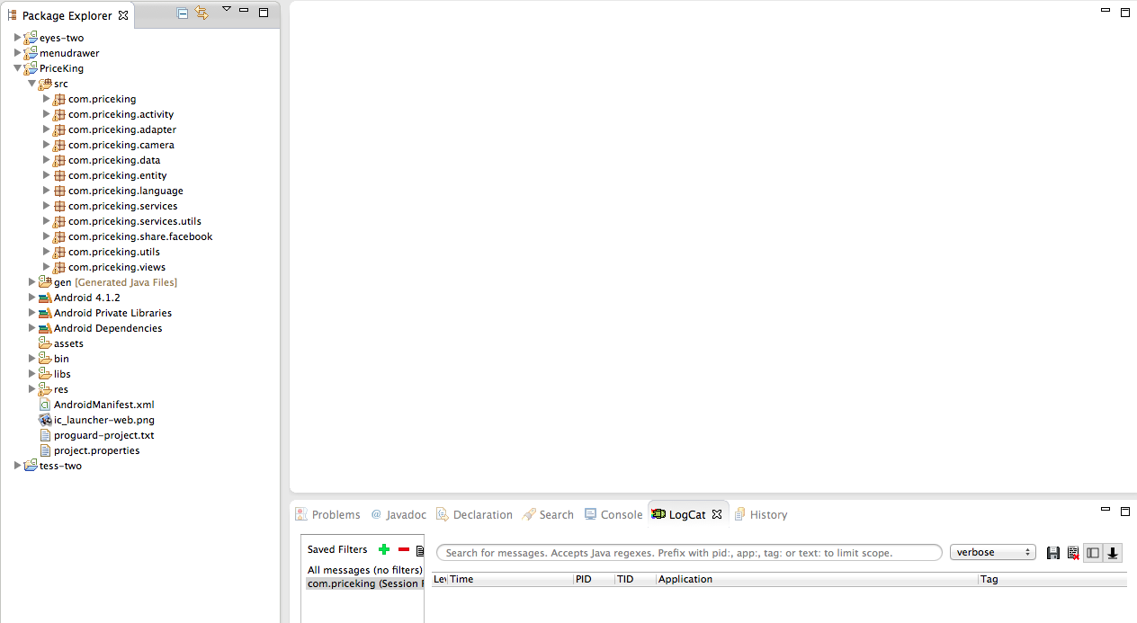
Mobile App- Project Structure

Slide 33
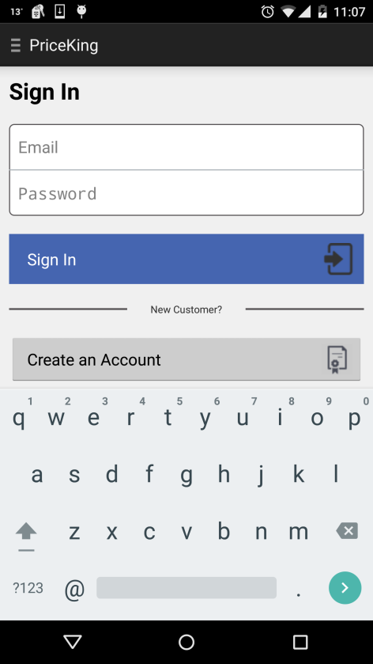
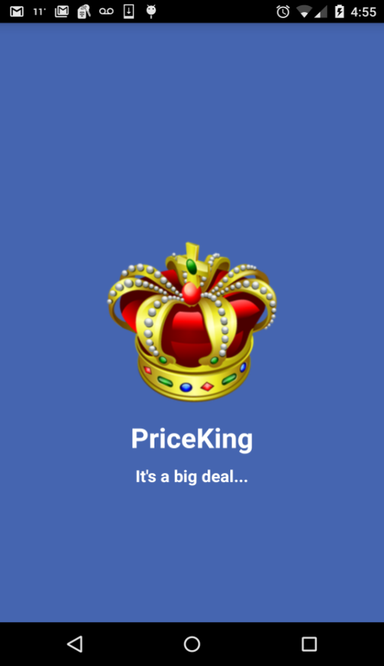
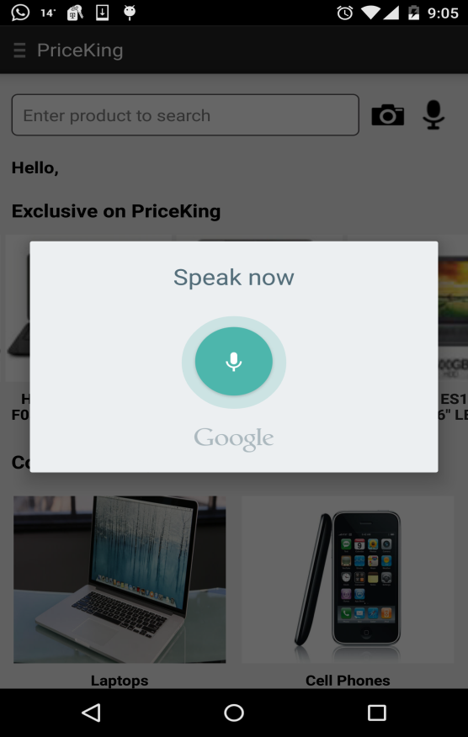
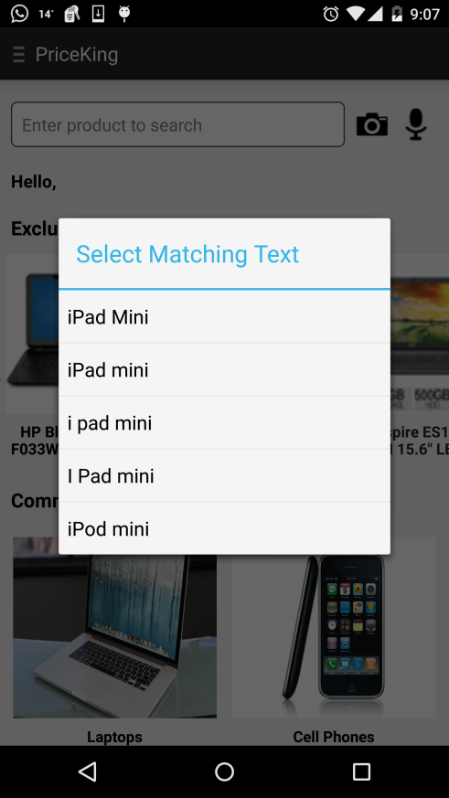
SignIn, Voice Recognition

Slide 34
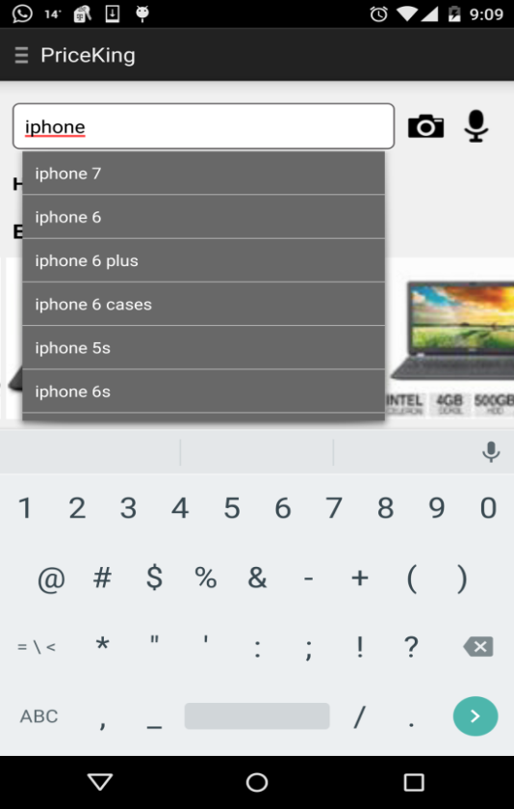
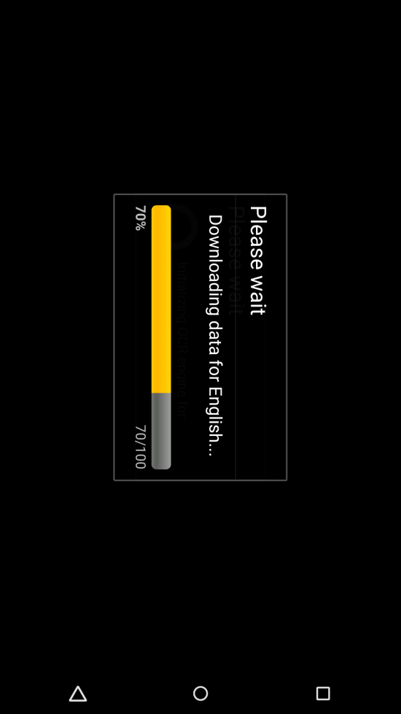
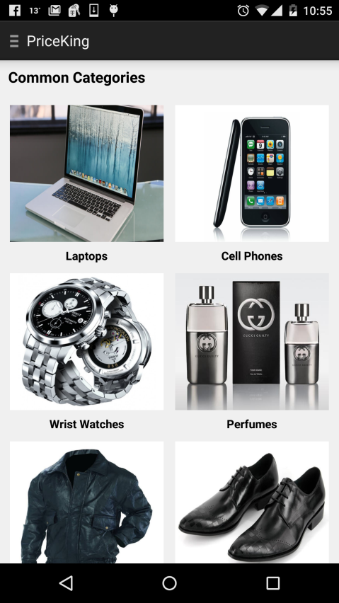
Search, Common Categories

Slide 35
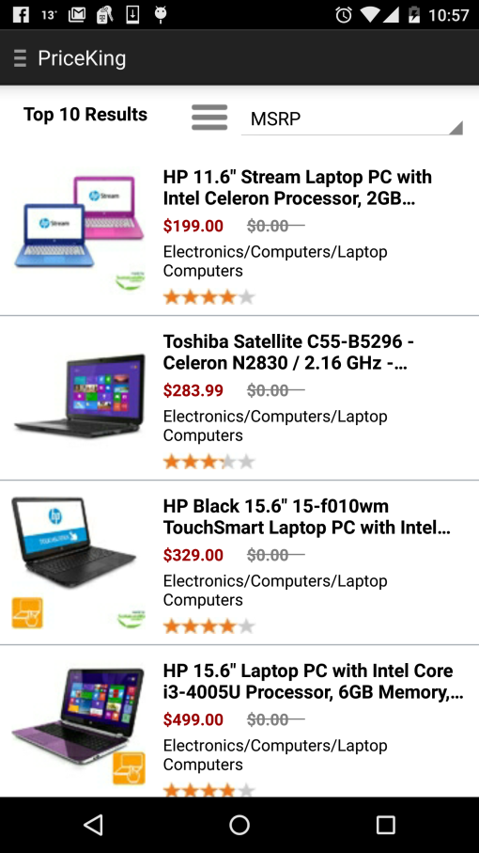
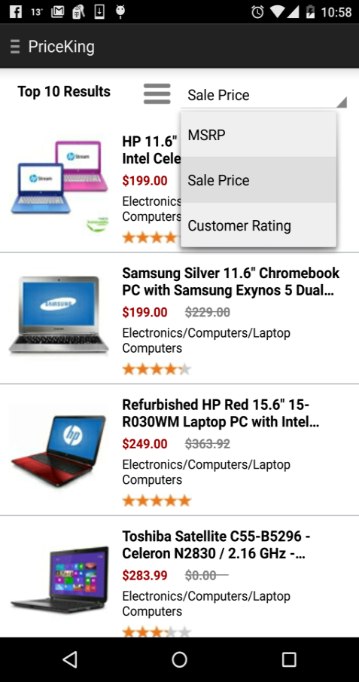
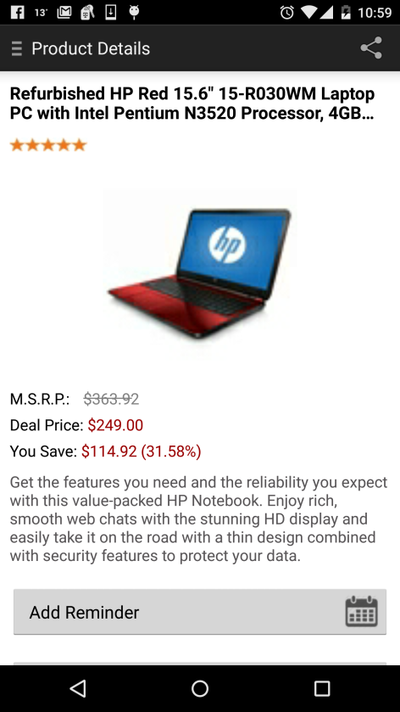
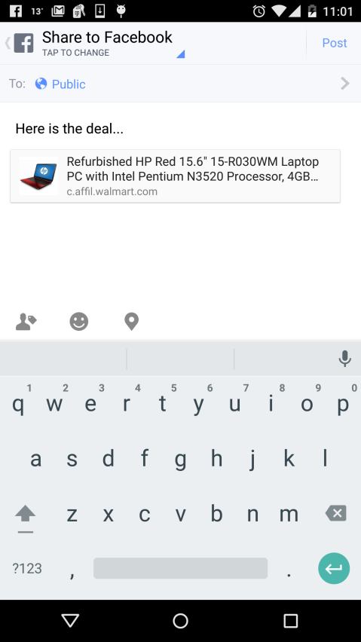
Sort, product details, Share

Slide 36
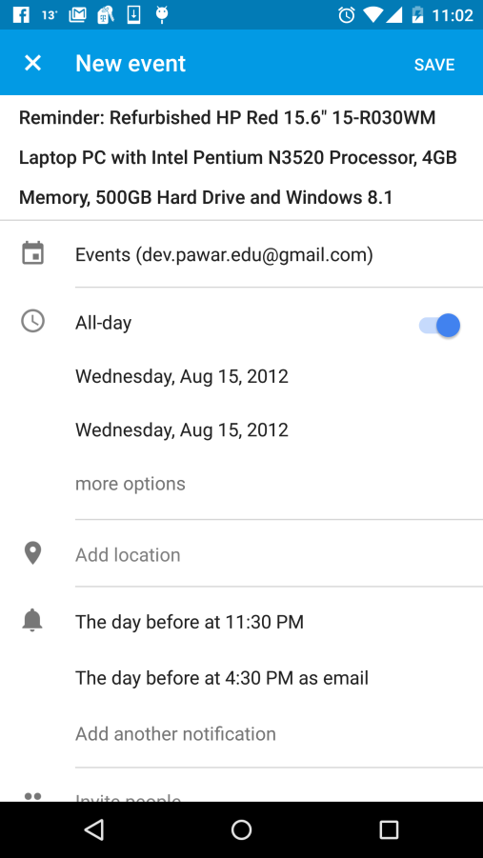
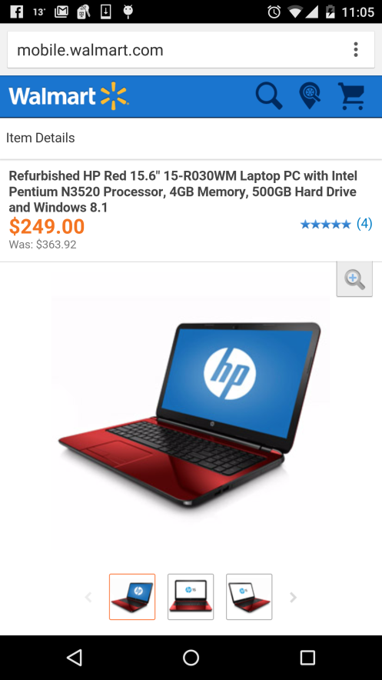
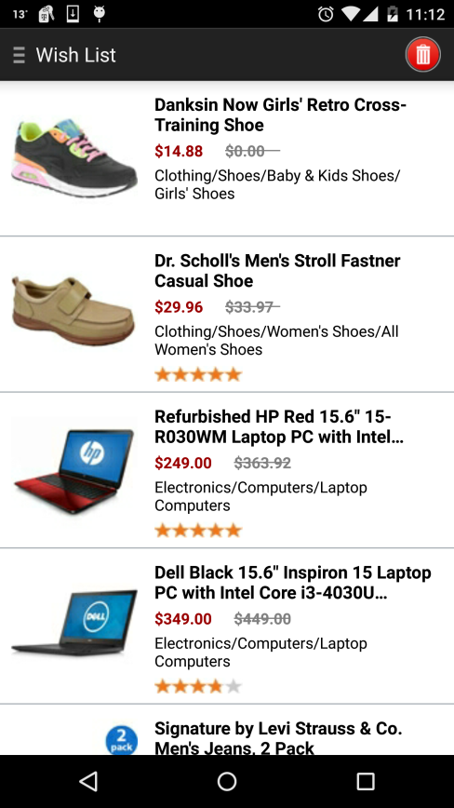
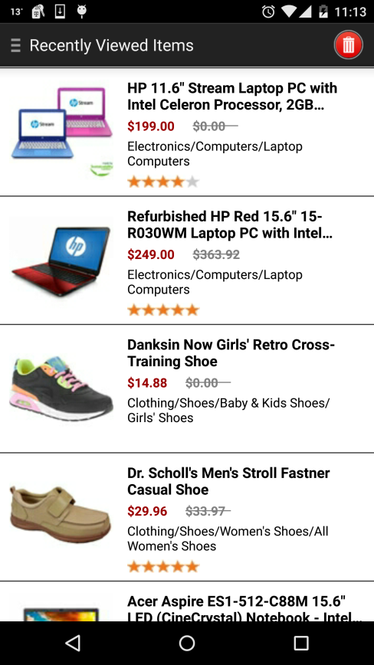
New Events, Buy, Wish List, Recently viewed

Slide 37
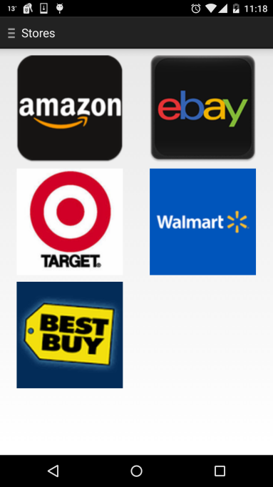
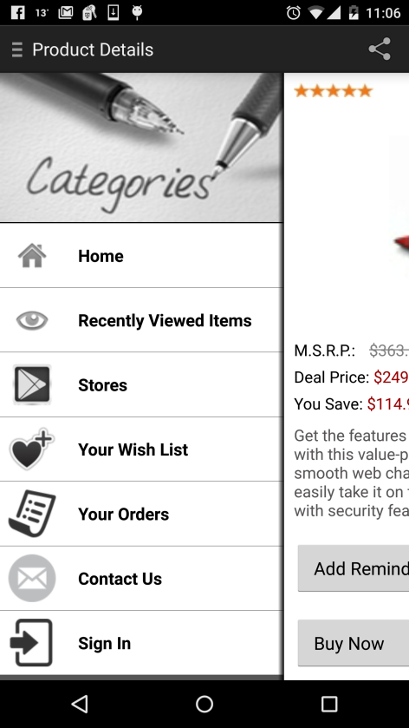

Stores, Slider

Slide 38


Slide 39


Slide 40

Testing- Testdroid, Junit

Slide 41


Slide 42

￼

Slide 43
Demo

